Slide 1
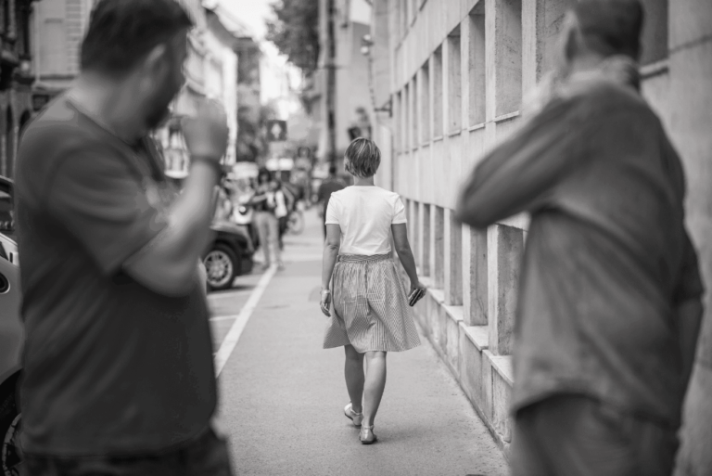

Fast greedy search.

Slide 2
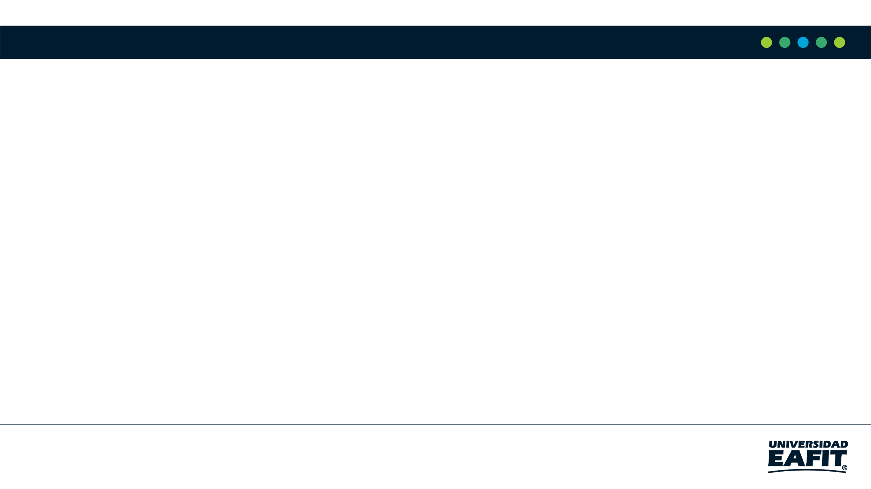



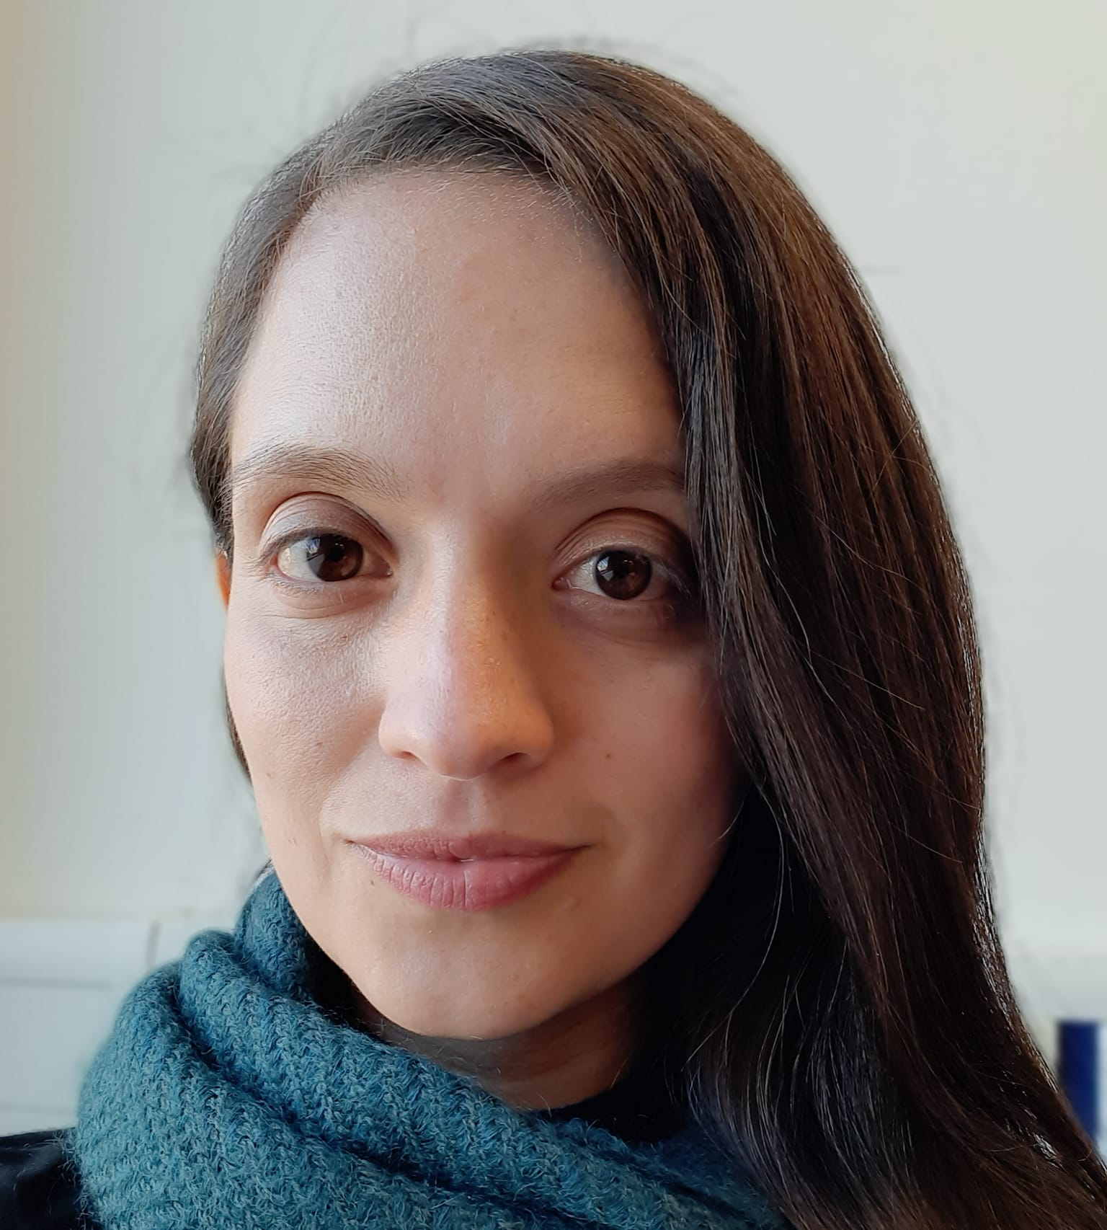

Presentation of the team
If possible, include the student first
Maximiliano Sanchez Lara Code, Technical Report, Leadership, and slides
Santiago Celis Loiaza
Research, Technical report
Andrea Serna
Literature review
Mauricio Toro
Data preparation
GitHub - MaximilianoSanLa/ST0245-002- MaxiSan: ST0245-002

Slide 3
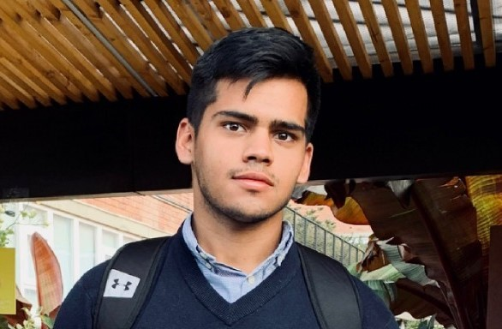
Other Members
Felipe Gomez Daza
Technical Report
GitHub - MaximilianoSanLa/ST0245-002- MaxiSan: ST0245-002

Slide 4
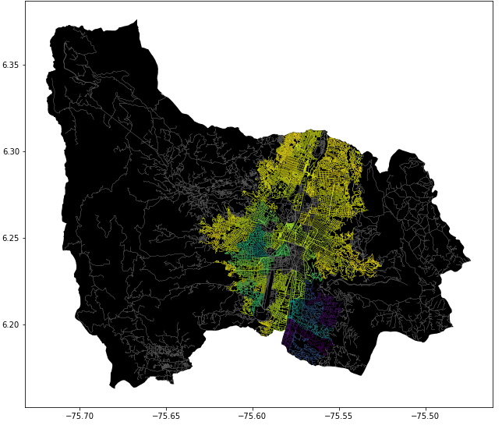
Problem Statement
Shortest path algorithm
Streets
of Medellín, Origin and Destination
Three paths that reduce both the risk of harassment and distance

Slide 5
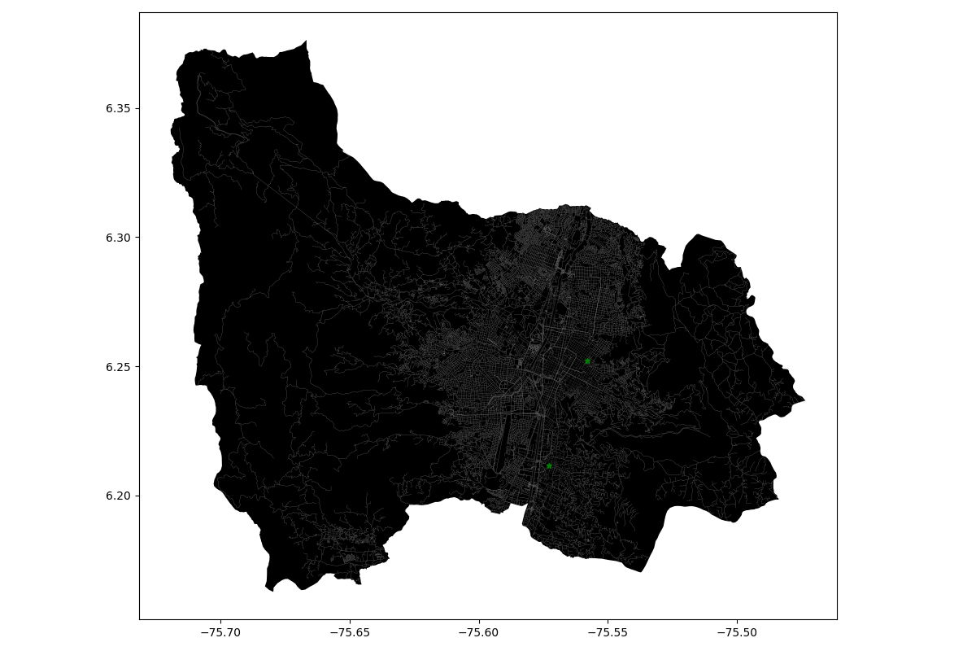
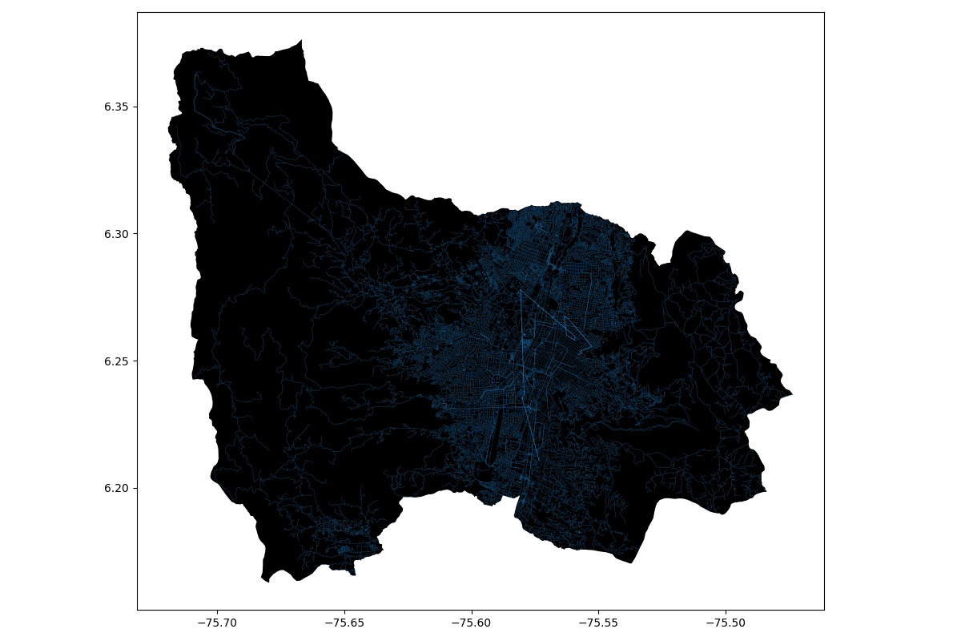
Solution Algorithm
Dijkstra
Streets
of Medellín, Origin and Destination
A path that reduces both distance and harassment

Slide 6
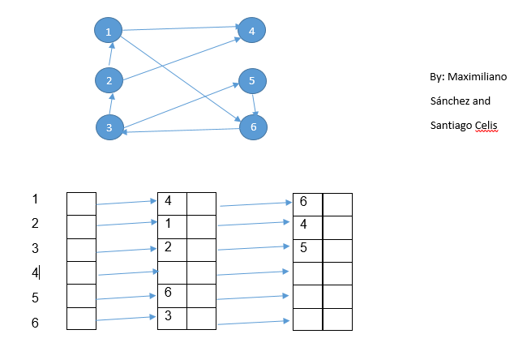
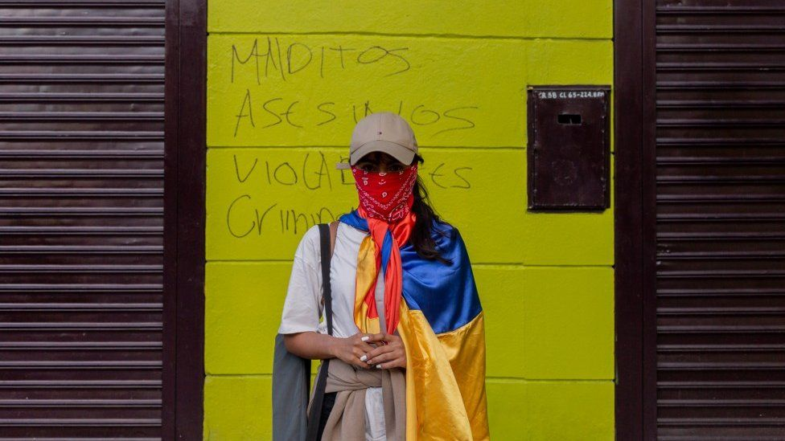
Explanation of the algorithm
Image extracted from: https://www.bbc.com/news/world-latin-america-57553316
Adjacent Dijkstra

Slide 7
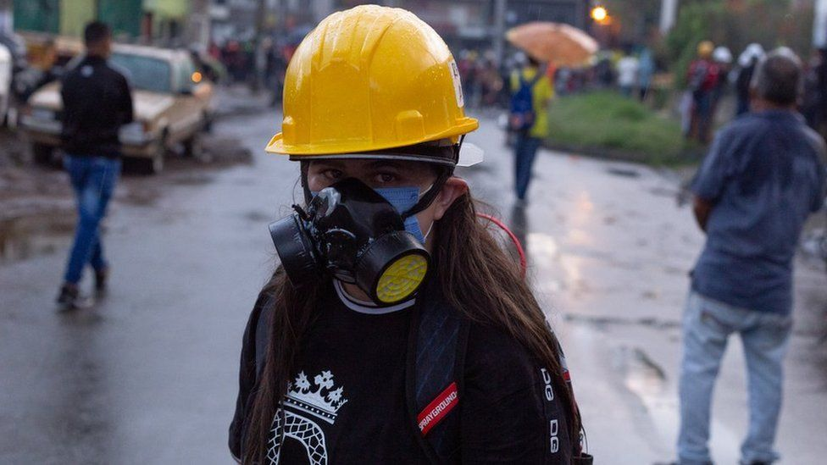
Complexity of the algorithm
Algorithm Name | Time complexity | Complexity of memory
Adjacent Disktra | O(Elog(V) | O(V)
In our algorithm V represents every node in our heap and E represents every node in our graph that changes accordingly to the node we are in.
Image extracted from: https://www.bbc.com/news/world-latin-america-57553316

Slide 8
First path minimizing d = ???
Origin | Destination | Distance (meters) | Risk of harassment (between 0 and 1)
Entrada a El Tesoro | UN Medellin | 8809.7229 | 0.6551682125112448
Distance and risk of harassment for the path that minimizes d =134.35522891971183. Execution time of 11.45 seconds.

Slide 9
Second path minimizing d = ???
Origin | Destination | Distance (meters) | Risk of harassment (between 0 and 1)
Entrada a El Tesoro | UN Medellin | 9839.547 | 0.6731124501596933
Distance and risk of harassment for the path that minimizes d =134.355. Execution time of 11.45 seconds.

Slide 10
Third path minimizing d = ???
Origin | Destination | Distance (meters) | Risk of harassment (between 0 and 1)
Entrada a El Tesoro | UN Medellin | 23194.528 | 0.6462234930749653
Distance and risk of harassment for the path that minimizes d =362.0257. Execution time of <11.45 seconds.

Slide 11

Visual comparison of the three paths

Slide 12
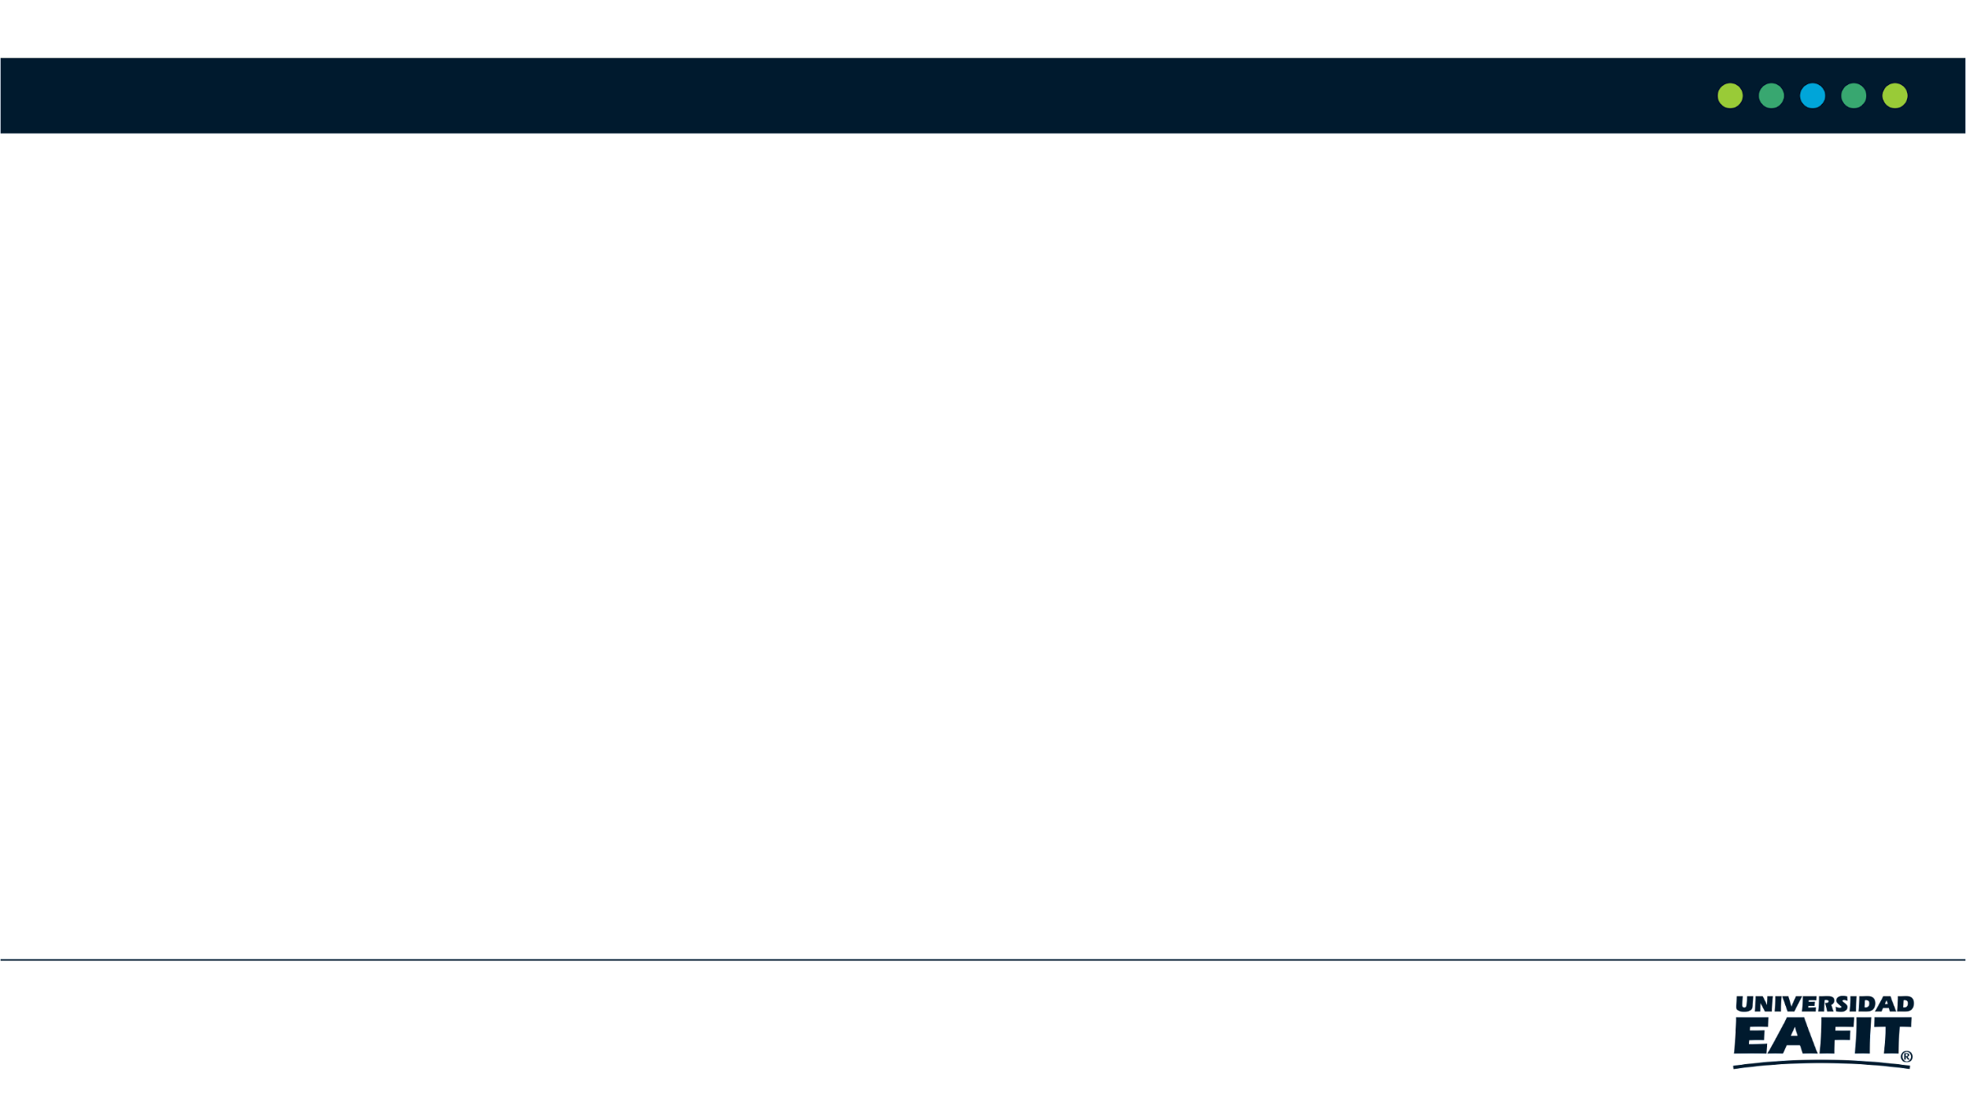
Future work directions
Databases
Electronic digital languages
Software Engineering
Information Systems
Other variables
Web application
Mobile application
Include ML or VR

Slide 13
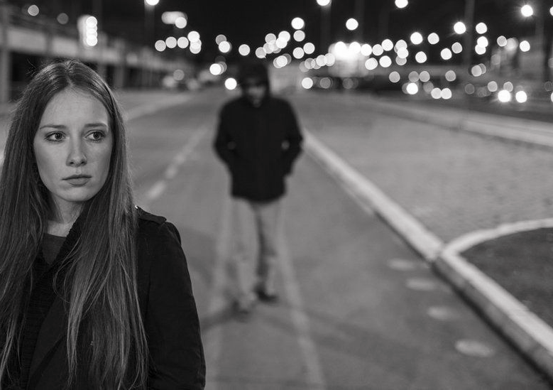
THANK YOU!!!
Special thanks
We are grateful to our families for funding our studies and for their continuous emotional support with them to, Universidad EAFIT, for their support in this research.

